Slide 1
Optimization of NFL Team Construction Using a Genetic Algorithm
Group 4
Evan Fox, Sumedh Khodke
Notes:
3 Minute Thesis
Motivation
possible outcome
possible data source
initial results if available

Slide 2
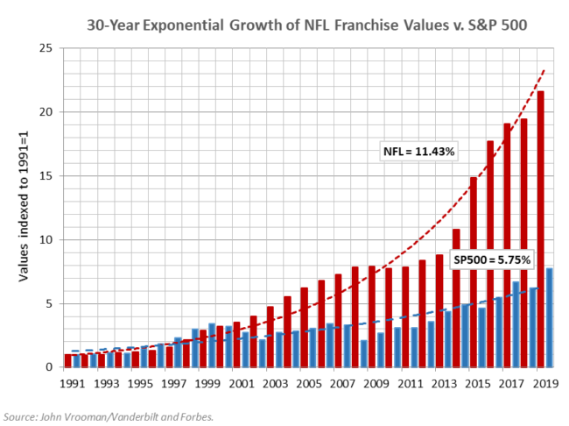
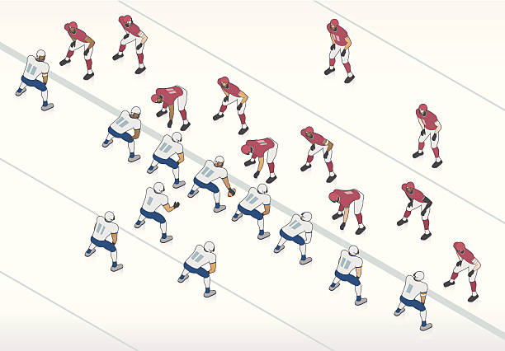
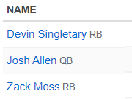
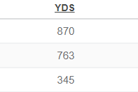
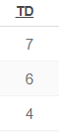
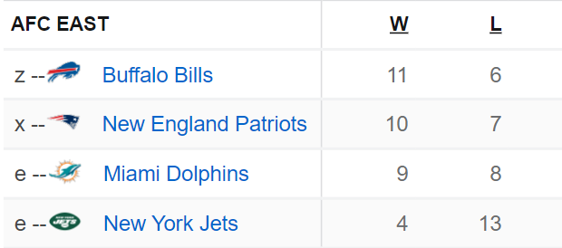


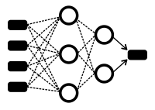



This project’s goal is to design a NFL team construction heuristic using a Genetic Algorithm with a learned fitness function that evaluates a team’s quality. The R Shiny application may explore optimal solutions, cluster player choices to illustrate the algorithm’s roster choices, and/or live-run the algorithm with custom team constraints.
Sports analytics is a new field with abundant opportunities for disruptive innovation.
Evolutionary
Algorithm
Generate Potential Rosters
(Initialize Individuals)
Machine Learning
(Fitness Function)
Inputs:
Roster
Player Statistics
Supervisor - Team Record / ELO / Point Differential
Evaluate Team Quality
(Survival Score / Fitness Function)
Select Best Teams
(“Survival of the fittest”)
Model:
XGBoost
Custom Neural Network
Generate New Rosters (Mutate / Evolve)
92
Output:
Team Quality
Select Best Team

